Slide 1
DATABASE MANAGEMENT SYSTEMS
COURSE CODE : 21CA1204

Slide 2
UNIT - 2
RELATIONAL ALGEBRA, INTRODUCTION TO SQL & INTERMEDIATE SQL
Relational Algebra –
  Selection and Projection,
  Set operations,
  Renaming
Introduction to SQL
DDL
DML Commands
Basic Structure of SQL Queries
Set Operations
Null Values
Aggregate Functions
Nested Sub Queries
Intermediate SQL
Joins, Views and Transactions.

Slide 3
Query Languages
A query language is a Language in which user requests information from the database.
Categories of languages
  Procedural
  Non-procedural, or declarative

Slide 4
Procedural Language/ Relational Algebra
Relational algebra is a procedural query language, which takes instances of relations as input and yields instances of relations as output.
It uses operators to perform queries. An operator can be either unary or binary.
They accept relations as their input and yield relations as their output.
Relational algebra is performed recursively on a relation and intermediate results are also considered relations.

Slide 5
Non Procedural Languages
In a non procedural language the user describes the desired information without giving a specific procedure for obtaining that information
Examples
  Relational algebra - procedural
  Tuple relational calculus – non procedural
  Domain relational calculus = non procedural

Slide 6
The fundamental operations of relational algebra are as follows −
Six basic operators
  select: σ
  project: ∏
  union: ∪
  set difference: –
  Cartesian product: x
  rename: ρ
  The operators- take one or two relations as inputs and produce a new relation as a result.

Slide 7
Basic operations:
  Selection ( ) Selects a subset of rows from relation.
  Projection ( ) Deletes unwanted columns from relation.
  Cross-product ( ) Allows us to combine two relations.
  Set-difference ( ) Tuples in reln. 1, but not in reln. 2.
  Union ( ) Tuples in reln. 1 and in reln. 2.
Additional operations:
  Intersection, join, division, renaming: Not essential, but (very!) useful.

Slide 8
SELECT (σ)
The SELECT operation is used for selecting a subset of the tuples according to a given selection condition.
Sigma(σ)Symbol denotes it.
It is used as an expression to choose tuples which meet the selection condition.
Select operator selects tuples that satisfy a given predicate.

Slide 9
SELECT (σ)
σ_{p}(r)
σ is the predicate
r stands for relation which is the name of the table
p is prepositional logic
σ _{topic = "Database"} (Tutorials)
Selects tuples from Tutorials where topic = 'Database'.

Slide 10
Selects tuples from Tutorials where the topic is 'Database' and 'author' is peter.
σ topic = "Database" and author = “peter"( Tutorials)
Selects tuples from Customers where sales is greater than 50000
σ _{sales > 50000} (Customers)

Slide 11
Projection(π)
This helps to extract the values of specified attributes to eliminates duplicate values.
(pi) symbol is used to choose attributes from a relation.
This operator helps you to keep specific columns from a relation and discards the other columns.
Notation − ∏_{A1, A2, An} (r)
Where A₁, A₂ , A_{n} are attribute names of relation r.
Duplicate rows are automatically eliminated, as relation is a set.

Slide 12
Consider the following table
CustomerID | CustomerName | Status
1 | Google | Active
2 | Amazon | Active
3 | Apple | Inactive
4 | Alibaba | Active

Slide 13
Π _{CustomerName, Status} (Customers)
CustomerName | Status
Google | Active
Amazon | Active
Apple | Inactive
Alibaba | Active

Slide 14
display the customerid,customername from customers where the status is inactive
π customerid,customername (σ status ="inactive"(customers))

Slide 15
Set Operations –
Union operation (υ)
UNION is symbolized by ∪ symbol.
It includes all tuples that are in tables A or in B.
It also eliminates duplicate tuples.
So, set A UaNION set B would be expressed as: AUB
For a union operation to be valid, the following conditions must hold -
R and S must be the same number of attributes.
Attribute domains need to be compatible.
Duplicate tuples should be automatically removed.

Slide 16
Consider the following Tables
Consider the following tables.
Table A |  |  | Table B
column 1 | column 2 |  | column 1 | column 2
1 | 1 |  | 1 | 1
1 | 2 |  | 1 | 3

Slide 17
Write the complete Values in Both A and B
Table A ∪ B (Intermediate Result)
column 1 | column 2
1 | 1
1 | 1
1 | 2
1 | 3

Slide 18
Remove the Duplicates
Table A ∪ B (Final Result)
column 1 | column 2
1 | 1
1 | 2
1 | 3

Slide 19
Set Difference (-)
- Symbol denotes it.
The result of A - B, is a relation which includes all tuples that are in A but not in B.
Rules
The attribute name of A has to match with the attribute name in B.
The two-operand relations A and B should be either compatible or Union compatible.
It should be defined relation consisting of the tuples that are in relation A, but not in B.

Slide 20
Write the complete Values in Both A and B
Table A - B (Intermediate Result)
column 1 | column 2
1 | 1
1 | 1
1 | 2
1 | 3

Slide 21
Keep only the values which is available in A and not in B
Table A - B (Final Result)
column 1 | column 2
1 | 2

Slide 22
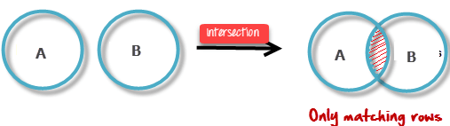
Intersection
An intersection is defined by the symbol ∩
A ∩ B
Defines a relation consisting of a set of all tuple that are in both A and B. However, A and B must be union-compatible.

Slide 23
Write the complete Values in Both A and B
Table A ∩ B (Intermediate Result)
column 1 | column 2
1 | 1
1 | 1
1 | 2
1 | 3

Slide 24
Keep only the values which is available in Both A and B
Table A ∩ B (Final Result)
column 1 | column 2
1 | 1

Slide 25
Rename(ρ)
Rename operator is used to give another name to a relation.
Syntax:
ρ(NewRelationname, OldRelationname)
To rename STUDENT relation to STUDENT1, we can use rename operator like:
ρ(STUDENT1, STUDENT)
ρ(S, STUDENT)

Slide 26
If you want to create a relation STUDENT_NAMES with ROLL_NO and NAME from STUDENT, it can be done using rename operator as:
ρ(STUDENT_NAMES, ∏_{(ROLL_NO, NAME)}(STUDENT))
Student(roll_no,name,age,grade)
∏_{(ROLL_NO, NAME)}(STUDENT)
Roll_no,name(student_names)

Slide 27
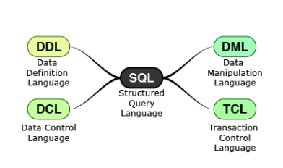
SQL STATMENTS
Structured Query Language (SQL) is used to manage data in all relational databases like DB2, Oracle, SQL Server etc. SQL standards are maintained by ISO.

Slide 28
What SQL CAN DO?
SQL is a standard language for storing, manipulating and retrieving data in databases.
SQL can execute queries against a database
SQL can retrieve data from a database
SQL can insert records in a database
SQL can update records in a database
SQL can delete records from a database
SQL can create new databases
SQL can create new tables in a database
SQL can create stored procedures in a database
SQL can create views in a database
SQL can set permissions on tables, procedures, and views

Slide 29
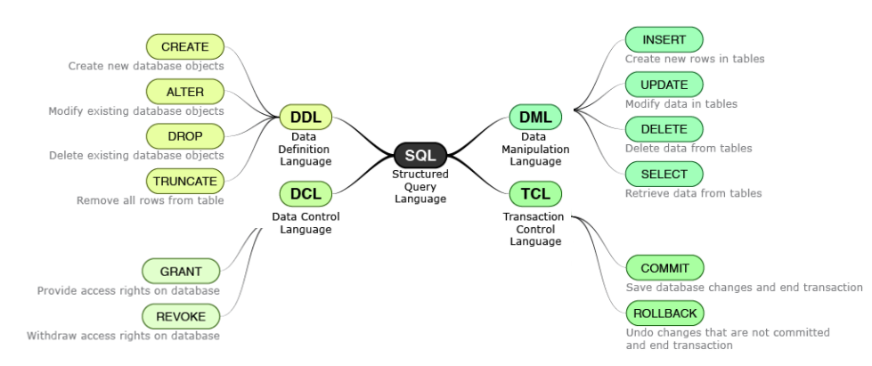

Slide 30
Although SQL is an ANSI/ISO standard, there are different versions of the SQL language.
They all support at least the major commands (such as SELECT, UPDATE, DELETE, INSERT, WHERE) in a similar manner.

Slide 31
SQL Data Types
SQL supports
SMALLINT
INTEGER
INT data types that are used for storing whole numbers

Slide 32
Non Integral Data Type
Nonintegral data types have an integer part and a fractional part.
Either NUMERIC, DECIMAL or NUMBER data types can be used to store nonintegral numbers.
Scale is the number of digits allowed after the decimal point.
Precision is the total number of digits before and after decimal points
significant digits i.e. digits both before and after the decimal point. If Scale is not provided then NUMBER datatype can be used to store integral values.

Slide 33
Data type | Description
BIT(size) | A bit-value type. The number of bits per value is specified in size. The size parameter can hold a value from 1 to 64. The default value for size is 1.
TINYINT(size) | A very small integer. Signed range is from -128 to 127. Unsigned range is from 0 to 255. The size parameter specifies the maximum display width (which is 255)
BOOL | Zero is considered as false, nonzero values are considered as true.
BOOLEAN | Equal to BOOL
SMALLINT(size) | A small integer. Signed range is from -32768 to 32767. Unsigned range is from 0 to 65535. The size parameter specifies the maximum display width (which is 255)
MEDIUMINT(size) | A medium integer. Signed range is from -8388608 to 8388607. Unsigned range is from 0 to 16777215. The size parameter specifies the maximum display width (which is 255)
INT(size) | A medium integer. Signed range is from -2147483648 to 2147483647. Unsigned range is from 0 to 4294967295. The size parameter specifies the maximum display width (which is 255)
INTEGER(size) | Equal to INT(size)
BIGINT(size) | A large integer. Signed range is from -9223372036854775808 to 9223372036854775807. Unsigned range is from 0 to 18446744073709551615. The size parameter specifies the maximum display width (which is 255)
FLOAT(size, d) | A floating point number. The total number of digits is specified in size. The number of digits after the decimal point is specified in the d parameter. This syntax is deprecated in MySQL 8.0.17, and it will be removed in future MySQL versions
FLOAT(p) | A floating point number. MySQL uses the p value to determine whether to use FLOAT or DOUBLE for the resulting data type. If p is from 0 to 24, the data type becomes FLOAT(). If p is from 25 to 53, the data type becomes DOUBLE()
DOUBLE(size, d) | A normal-size floating point number. The total number of digits is specified in size. The number of digits after the decimal point is specified in the d parameter
DOUBLE PRECISION(size, d)
DECIMAL(size, d) | An exact fixed-point number. The total number of digits is specified in size. The number of digits after the decimal point is specified in the d parameter. The maximum number for size is 65. The maximum number for d is 30. The default value for size is 10. The default value for d is 0.
DEC(size, d) | Equal to DECIMAL(size,d)

Slide 34
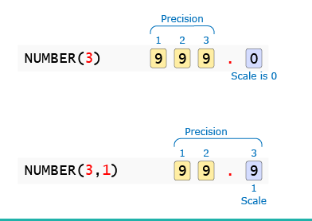
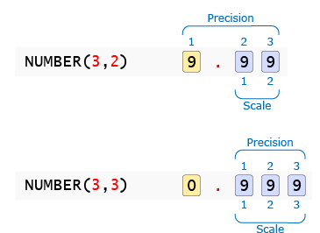
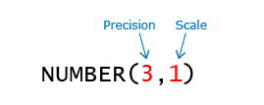

Slide 35
Date Data types
Data type | Description
DATE | A date. Format: YYYY-MM-DD. The supported range is from '1000-01-01' to '9999-12-31'
DATETIME(fsp) | A date and time combination. Format: YYYY-MM-DD hh:mm:ss. The supported range is from '1000-01-01 00:00:00' to '9999-12-31 23:59:59'. Adding DEFAULT and ON UPDATE in the column definition to get automatic initialization and updating to the current date and time
TIMESTAMP(fsp) | A timestamp. TIMESTAMP values are stored as the number of seconds since the Unix epoch ('1970-01-01 00:00:00' UTC). Format: YYYY-MM-DD hh:mm:ss. The supported range is from '1970-01-01 00:00:01' UTC to '2038-01-09 03:14:07' UTC. Automatic initialization and updating to the current date and time can be specified using DEFAULT CURRENT_TIMESTAMP and ON UPDATE CURRENT_TIMESTAMP in the column definition
TIME(fsp) | A time. Format: hh:mm:ss. The supported range is from '-838:59:59' to '838:59:59'
YEAR | A year in four-digit format. Values allowed in four-digit format: 1901 to 2155, and 0000.
 | MySQL 8.0 does not support year in two-digit format.

Slide 36
Sql String Data Types
SQL supports two character / String data types for storing printable and displayable characters. They are used for storing information like name, address, description etc

Slide 37
CHAR(n) | VARCHAR2(n)
Useful for | Storing characters having pre-determined length | Storing characters whose length vary a lot
Storage size | size for n characters | size for actual no. of characters + fixed size to store length
Storage Characteristic | Trailing spaces are applied if data to be stored has smaller length than n. | Trailing spaces are not applied.
Maximum size | 2000 bytes | 4000 bytes
Example | A CHAR(10) field will store "Hello" as 10 bytes by appending 5 trailing spaces. | A VARCHAR2(10) field will store "Hello" as 7 bytes (assuming 2 bytes to store length).
Alternate Name | CHARACTER(n) | CHARACTER VARYING(n)

Slide 38
String Data Types
Data type | Description
CHAR(size) | A FIXED length string (can contain letters, numbers, and special characters). The size parameter specifies the column length in characters - can be from 0 to 255. Default is 1
VARCHAR(size) | A VARIABLE length string (can contain letters, numbers, and special characters). The size parameter specifies the maximum column length in characters - can be from 0 to 65535
BINARY(size) | Equal to CHAR(), but stores binary byte strings. The size parameter specifies the column length in bytes. Default is 1
VARBINARY(size) | Equal to VARCHAR(), but stores binary byte strings. The size parameter specifies the maximum column length in bytes.
TINYBLOB | For BLOBs (Binary Large OBjects). Max length: 255 bytes
TINYTEXT | Holds a string with a maximum length of 255 characters
TEXT(size) | Holds a string with a maximum length of 65,535 bytes
BLOB(size) | For BLOBs (Binary Large OBjects). Holds up to 65,535 bytes of data
MEDIUMTEXT | Holds a string with a maximum length of 16,777,215 characters
MEDIUMBLOB | For BLOBs (Binary Large OBjects). Holds up to 16,777,215 bytes of data
LONGTEXT | Holds a string with a maximum length of 4,294,967,295 characters
LONGBLOB | For BLOBs (Binary Large OBjects). Holds up to 4,294,967,295 bytes of data
ENUM(val1, val2, val3, ...) | A string object that can have only one value, chosen from a list of possible values. You can list up to 65535 values in an ENUM list. If a value is inserted that is not in the list, a blank value will be inserted. The values are sorted in the order you enter them
SET(val1, val2, val3, ...) | A string object that can have 0 or more values, chosen from a list of possible values. You can list up to 64 values in a SET list

